Slide 1
Microcontroller Intel 8051
[Architecture]

Slide 2
The Microcontroller
Microcontrollers can be considered as self-contained systems
  with a processor, memory and I/O ports.
  In most cases, all that is missing is the software to define the operation of the embedded system.
Usually available in several forms:
  Devices for prototyping
    Built-in or piggy-back EPROM for storing the software.
  One Time Programmable (OTP) devices.
    No window on the package. Therefore, the internal EPROM cannot be erased after being programmed.
  High Volume Production devices.
    Use ROM internally to hold the software. Cheaper in large volume.

Slide 3
The Architectural Needs of a Microcontroller
Lets consider what architectural features would be needed in a microcontroller.
What are the expected applications?
  Sensing the environment (Input)
  Producing a response (Output)
  The response may be delayed (Timer/Counter)
  Prioritized response (Interrupts)
  Software to control the process (Non-volatile Memory)
  Temporary data (RAM)

Slide 4
Major Microcontroller Families
There are several major “families” of microcontrollers available from different manufacturers.
  A family is defined as a group of products that share the same basic internal architectures and who are code-compatible.
  Manufacturers usually define an architecture and then make variants of that design producing a family of products.
  Code written for a member of the family should be compatible with all other members of the same family.

Slide 5
Example Microcontroller Families
Z80 from Zilog
  8-bit microprocessor based on the 8080 architecture.
  Capable of 1 MIP at 4 MHz. (Millions of Instructions Per Second)
  Accumulator, 6 8-bit registers, 2 index registers.
  Uses external RAM for temporary data.
  Built-in refresh circuitry for the external RAM.
  Only port-based I/O.
  Slowly disappearing.

Slide 6
Example Microcontroller Families …Cont.
MC6811 from Motorola
  8-bit stack-based architecture.
  2 accumulators and 2 index registers.
  Built in EEPROM and RAM.
  Digital I/O.
  Timers.
  ADC.
  RS232 communication.
  Was the most powerful and flexible controller available at introduction.
    Around 1970.
  Still very popular.

Slide 7
The MCS-51 Family of Microcontrollers
Originally introduced by Intel in 1981.
  Currently, the most widely used microcontroller.
  8-bit processor.
  2 distinct separately addressable memory areas.
    Maximum of 64K on-chip ROM.
      Usually 0 to 4K.
    Maximum of 64K external data memory.
    Maximum of 64K external code memory.
    Basic version (8051) contains:
      4K Bytes of on-chip ROM instruction memory.
      128 Bytes of on-chip RAM for temporary data storage and the stack.
  2 timers, one serial port, and four 8-bit parallel I/O ports.
  Speeds starting from12 MHz.

Slide 8
8051 Features
64KB Program Memory address space
64KB Data Memory address space
4K bytes of on-chip Program Memory
128 bytes of on-chip Data RAM
32 bidirectional and individually addressable 1/0 lines
Two 16-bit timer/counters
Full duplex UART
6-source/5-vector interrupt structure with two priority levels
On-chip clock oscillator
*
TE IT SEM-V

Slide 9
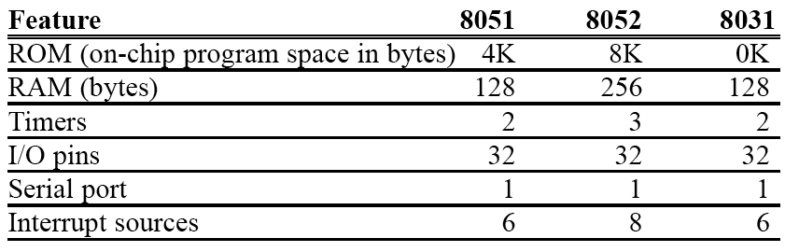
Features of the 8051 Microcontroller
The 8031 requires external instruction memory.
  It can be as large as 64K Bytes.
  You lose 2 ports for interfacing to the external memory.
    You can replace these by interfacing the chip to an I/O port controller like the 8255.
The 8051 is the original member of the Intel MCS-51 family of Microcontrollers.
  There are several varieties that differ slightly in the available features.

Slide 10
Manufacturers of MCS-51 Clones
There is a large number of companies that manufacture microcontrollers in the 8051 family.
  ATMEL Corporation.
    Flash instead of EPROM.
    Low Voltage.
    Minimal version with less memory and fewer I/O ports in a smaller package.
    CMOS implementation.
    Speeds that range from 12 to 20 MHz.

Slide 11
Manufacturers of MCS-51 Clones
  Dallas Semiconductor
    Uses NV-RAM. Programmable in-system.
    As large as 32K of instruction memory.
    Some versions have an on-chip real-time clock.
  Philips Corporation.
    Large selection of 8051 based microcontrollers.
    Include features like A/D and D/A on chip.
  Xilinx and Altera
    8051 FPGA cores.

Slide 12
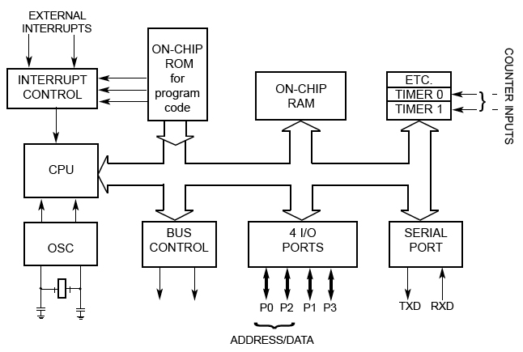
The 8051 Microcontroller Internals

Slide 13
8051 Architecture
Programmer’s View
  Memory Organization
  Register Set
  Instruction Set
Hardware Designer’s View
  Pin-out
  Timing characteristics
  Current / Voltage requirements

Slide 14
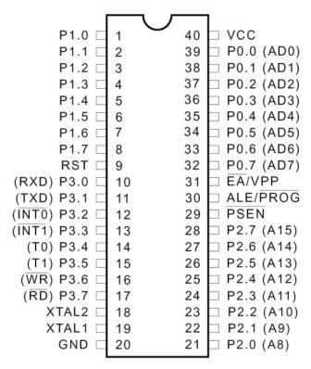
Pin Diagram of the 8051
*
TE IT SEM-V

Slide 15
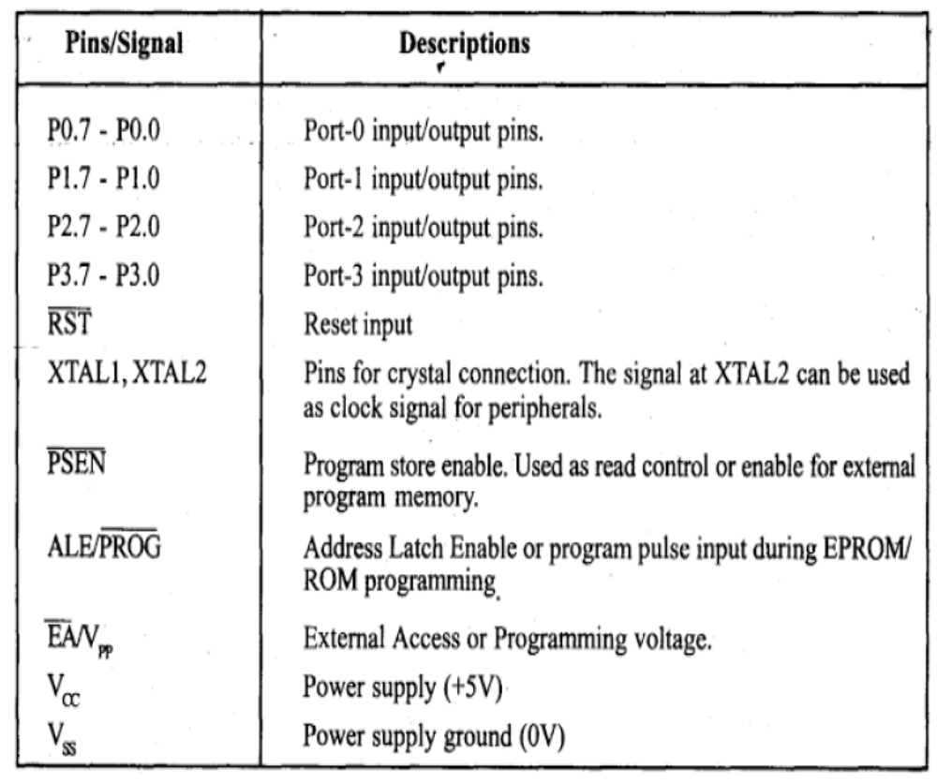

Slide 16
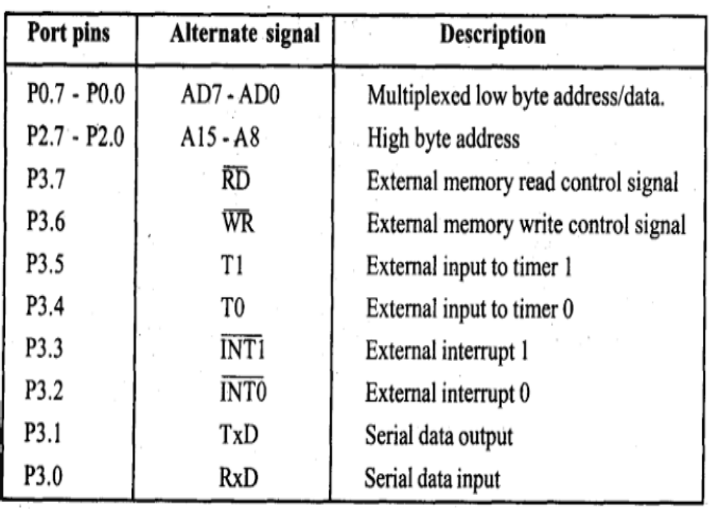

Slide 17
Memory Organization
The 8051 has separate address spaces for
program storage and data storage.
  Depending on the type of instruction, the same address can refer to two logically and physically different memory locations.

Slide 18
Program Storage
After reset, the MCS-51 starts fetching instructions from 0000H.
  This can be either on-chip or external depending on the value of the EA input pin.
    If EA* is low, then the program memory is external.
    If EA* is high, then addresses from 0000 to 0FFF will refer to on-chip memory and addresses 1000 up to FFFF refer to external memory.
  Note that the 8031 must have its EA connected low as all of its memory is external.
Link: EA connection

Slide 19

8051 Memory Structure
External
60K
External
64K
64K
SFR
EXT
INT
4K
128
EA = 0
EA = 1
Program Memory
Data Memory
*
TE IT SEM-V

Slide 20
Access to External Memory
Port 0 acts as a multiplexed address/data bus. Sending the low byte of the program counter (PCL) as an address.
Port 2 sends the program counter high byte (PCH) directly to the external memory.
The signal ALE operates as in the 8051 to allow an external latch to store the PCL byte while the multiplexed bus is made ready to receive the code byte from the external memory.
Port 0 then switches function and becomes the data bus receiving the byte from memory.

Slide 21
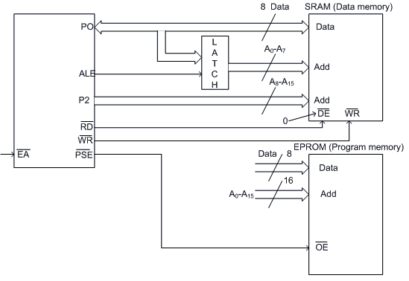
Circuit Diagram for Interfacing of External Memory
For External Code Memory, PSEN’ = 0
For External Data Memory, PSEN’ = 1
External program memory is fetched if either of the following two conditions are satisfied.
EA (Enable Address) is low. The microcontroller by default starts searching for program from external program memory.
PC is higher than FFFH for 8051 or 1FFFH for 8052.

Slide 22
8051 Addressing Modes
8051 has four addressing modes.
1. Immediate Addressing : Data is immediately available in the instruction. For example - ADD A, #77; Adds 77 (decimal) to A and stores in A ADD A, #4DH; Adds 4D (hexadecimal) to A and stores in A MOV DPTR, #1000H; Moves 1000 (hexadecimal) to data pointer

Slide 23
2. Bank Addressing or Register Addressing : This way of addressing accesses the bytes in the current register bank. Data is available in the register specified in the instruction. The register bank is decided by 2 bits of Processor Status Word (PSW). For example- ADD A, R0; Adds content of R0 to A and stores in A
3.. Direct Addressing : The address of the data is available in the instruction. For example - MOV A, 088H; Moves content of SFR TCON (address 088H)to A
4. Register Indirect Addressing : The address of data is available in the R0 or R1 registers as specified in the instruction. For example - MOV A, @R0 moves content of address pointed by R0 to A

Slide 24
External Data Addressing : Pointer used for external data addressing can be either R0/R1 (256 byte access) or DPTR (64kbyte access). For example - MOVX A, @R0; Moves content of 8-bit address pointed by R0 to A MOVX A, @DPTR; Moves content of 16-bit address pointed by DPTR to A
External Code Addressing : Sometimes we may want to store non-volatile data into the ROM e.g. look-up tables. Such data may require reading the code memory. This may be done as follows - MOVC A, @A+DPTR; Moves content of address pointed by A+DPTR to A MOVC A, @A+PC; Moves content of address pointed by A+PC to A

Slide 25
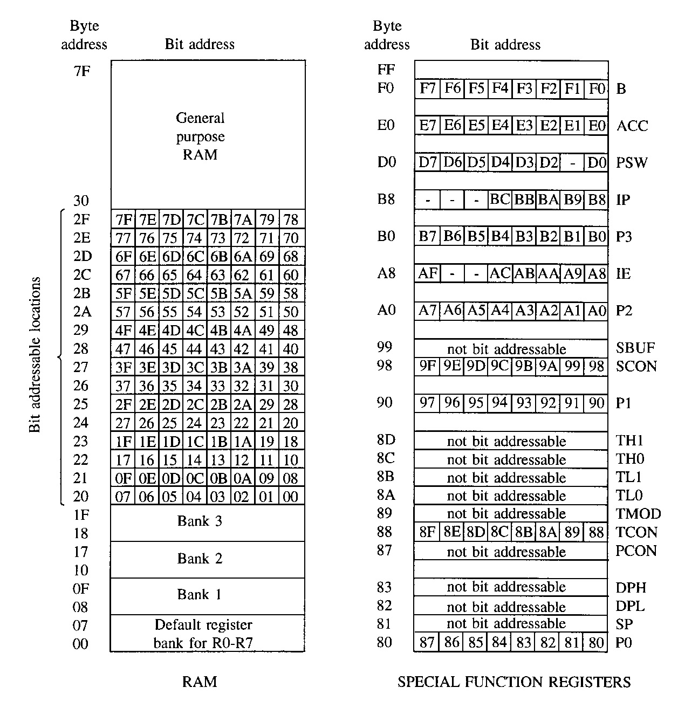
Data Storage
The 8051 has 256 bytes of RAM on-chip.
  The lower 128 bytes (00 – 7F) are intended for internal data storage.
  The upper 128 bytes (80-FF)are the Special Function Registers (SFR).
The lower 128 bytes are not to be used as standard RAM.
  Internally 8051’s registers default to stack area, and other features. [00-7FH]
Lower 128 bytes: 00 – 7F
Link: Memory Organization

Slide 26
Data Storage [Cont...]
The lowest 32 bytes of the on-chip RAM form 4 banks of 8 registers each.
Only one of these banks can be active at any time.
Bank is chosen by setting 2 bits in PSW
  Default bank (at power up) is bank 0 (locations 00 – 07).
The 8 registers in any active bank are referred to as R0 through R7
Stack pointer on reset is at 07 H
Given that each register has a specific address, it can be accessed directly using that address even if its bank is not the active one.

Slide 27
Data Storage [Cont...]
The next 16 bytes – locations 20H to 2FH – form a block that can be addressed as either bytes or individual bits.
  The bytes have addresses 20H to 2FH.
  The bits have addresses 00H to 7FH.
  Specific instructions are used for accessing
  the bits.
Locations 30H to 7FH are general purpose RAM.
Link: Memory Organization

Slide 28
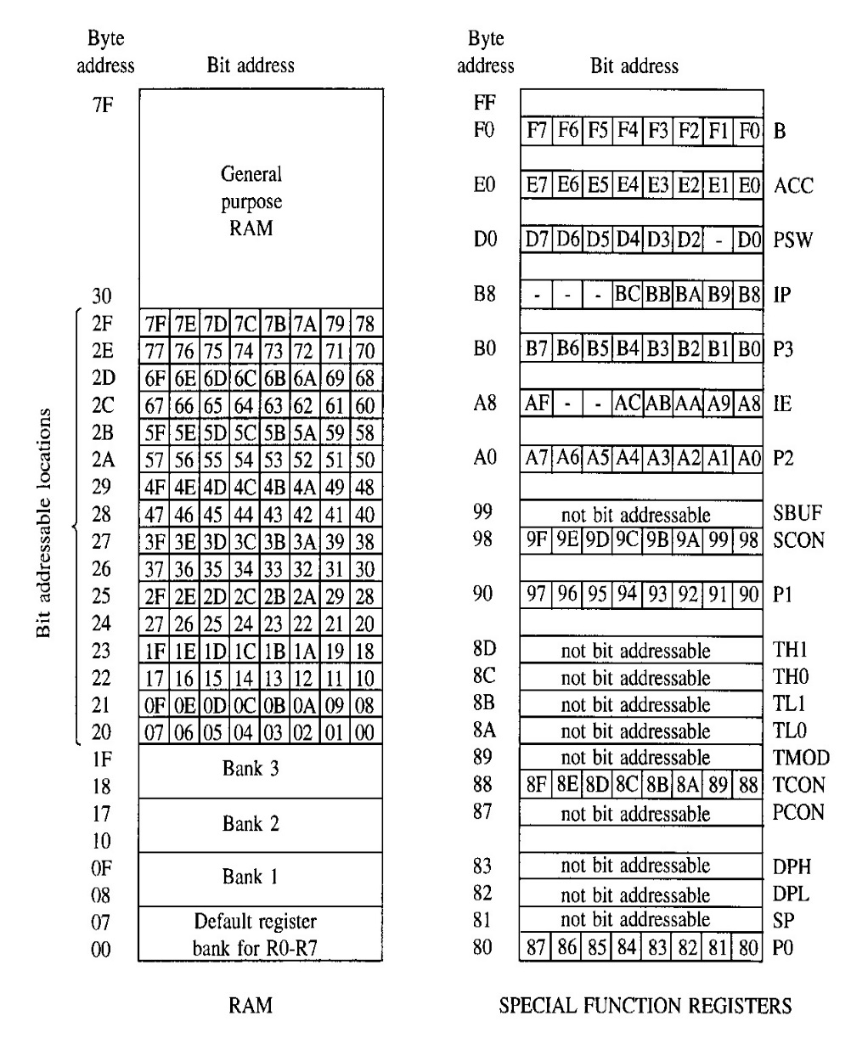
The SFR (Special Function Register)
The upper 128 bytes of the on-chip RAM are used to house special function registers.
    In reality, only about 25 of these bytes are actually used. The others are reserved for future versions of the 8051.
  These are registers associated with important functions in the operation of the MCS-51.
  Some of these registers are bit-addressable as well as byte-addressable.
    The address of bit 0 of the register will be the same as the address of the register.

Slide 29
The Elements of SFR
ACC and B registers – 8 bit each
DPTR : [DPH:DPL] – 16 bit combined
PC (Program Counter) – 16 bits
SP (Stack Pointer) – 8 bit
PSW (Program Status Word)
Port Latches
Serial Data Buffer
Timer Registers
Control Registers
Link: SFR Elements

Slide 30
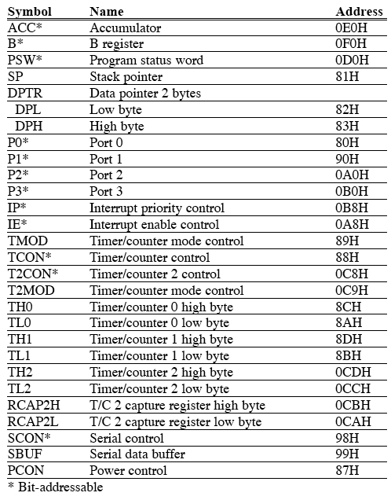

Slide 31
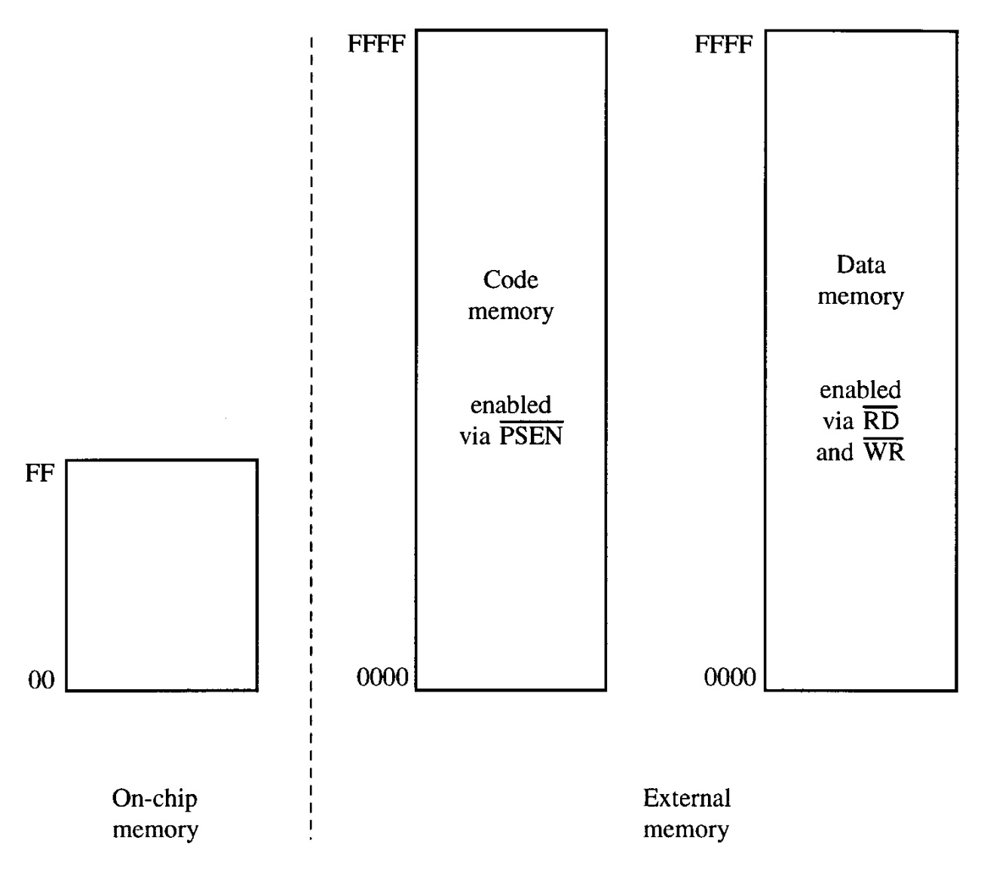

Slide 33
The ACC – Accumulator
Commonly used for move and arithmetic instructions.
Can be referred to in several ways:
  Implicitly in op-codes.
  Referred to as ACC (or A) for instructions that allow specifying a register.
  By its SFR address 0E0H.
Operates in a similar manner to the 8085 accumulator.
Bit addressable.
  ACC.2 means bit 2 of the ACC register.

Slide 34
The B Register
Commonly used as a temporary register, much like a 9th R register.
Used by two op-codes
  MUL AB, div AB
B register holds the second operand and will hold part of the result
  Upper 8 bits of the multiplication result
  Remainder in case of division.
Can also be accessed through its SFR address of 0F0H.
Bit addressable.

Slide 35
The DPL and DPH Registers
2 8-bit registers that can be combined into a 16-bit DPTR – Data Pointer.
Used by commands that access external memory
Also used for storing 16bit values
mov DPTR, #data16
; setup DPTR with 16bit ext address
movx A, @DPTR
; copy mem[DPTR] to A
Can be accessed as 2 separate 8-bit registers if needed.
DPTR is useful for string operations and Look-Up-Table (LUT) operations.

Slide 36
The SP Register
SP is the stack pointer.
SP points to the last used location of the stack.
  Push operation will first increment SP and then copy data.
  Pop operation will first copy data and then decrement SP.
In 8051, stack grows upwards (from low memory to high memory) and can be in the internal RAM only.
On power-up, SP points to 07H.
  Register banks 2,3,4 (08H to 1FH) form the default stack area.
Stack can be relocated by setting SP to the upper memory area in 30H to 7FH.
  mov SP, #32H

Slide 37
The PSW Register
Program Status Word is a “bit addressable” 8-bit register that has all the flags.
MSB |  |  |  |  |  |  | LSB
CY | AC | F0 | RS1 | RS2 | OV | - | P
Symbol | Position | Function
CY | PSW.7 | Carry Flag
AC | PSW.6 | Auxiliary Carry Flag. For BCD Operations
F0 | PSW.5 | Flag 0. Available to the user for general purposes.
RS1 | PSW.4 | Register bank select bits. Set by software to determine which register bank is being used.
RS2 | PSW.3
OV | PSW.2 | Overflow Flag
- | PSW.1 | Not used
P | PSW.0 | Parity Flag. Even Parity. P=1 A contains an odd no. of 1’s

Slide 38
The P0, P1, P2, and P3 Registers
Port Latches.
Specify the value to be output on the specific output port or the value read from the specific input port.
Bit addressable.
  First bit has the same address as the register.
  Example: P1 has address 90H in the SFR, so
    P1.7 or address 97H refer to the same bit.
Link: SFR address

Slide 39
The SBUF Register
Serial Port Data Buffer.
2 registers at the same location
  One is read-only used for reading serial input data.
    Serial Data Receive Buffer.
  The other is write-only used for storing serial output data.
    Serial Data Transmit Buffer.
Link: SFR address

Slide 40
Timer Registers – TH0 and TL0
The high and low bytes of the 16-bit counting register for timer/counter T0.
There is also a TH1 / TL1 pair for the T1 timer.
In the 8052, one more pair exists (TH2) / (TL2) for the T2 timer.
(RCAP2H) and (RCAP2L) exist only in the 8052 and they are copies of the TH2 and TL2 registers.
Link: SFR address

Slide 41
Control Registers
IP – Interrupt Priority.
IE – Interrupt Enable.
TMOD – Timer Mode.
TCON – Timer Control.
T2CON – Timer 2 Control (8052)
SCON – Serial Port Control.
PCON – Power Control (80C51).
Link: SFR address

